Slide 1


Intermediate Python
Decorators & Class Gotchas

Slide 2
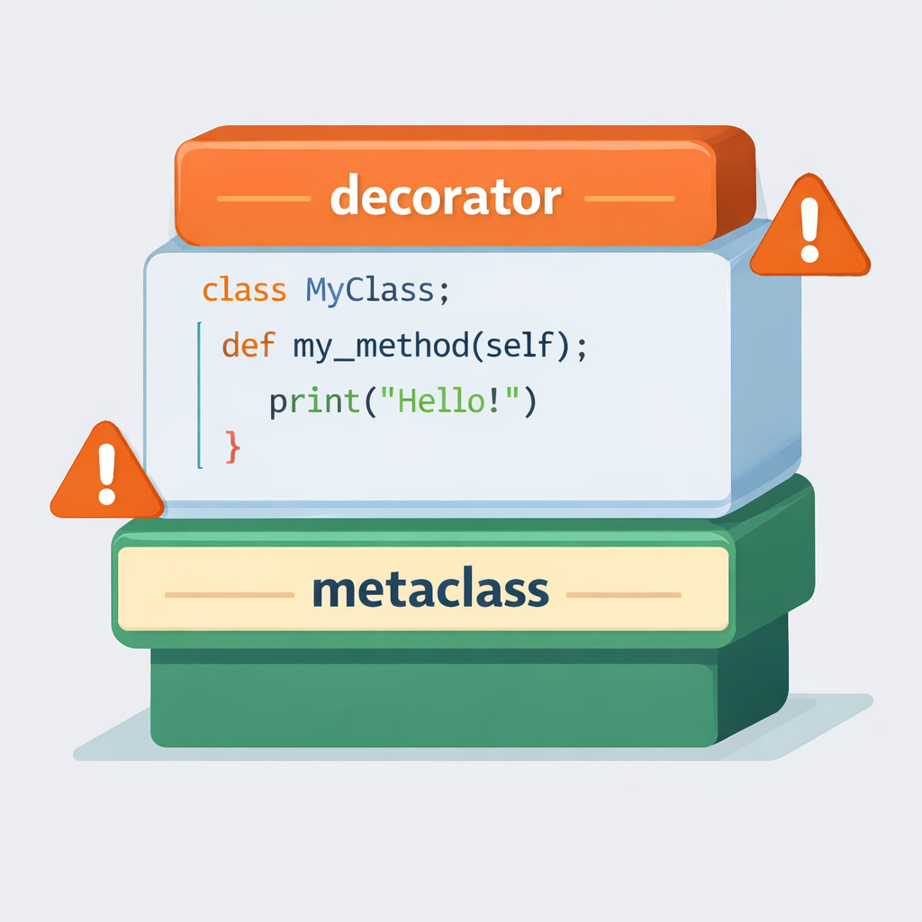
Decorators & Class Gotchas: Why This Matters
Decorators and metaclasses are powerful tools—but misuse leads to fragile designs.
Python allows behavior modification without changing code
Power increases abstraction and complexity
Hard-to-debug bugs often come from “clever” code
Understanding limits is as important as features
Design discipline prevents technical debt
Notes:
Set the tone: this session is about judgment, not just syntax. Most production bugs come from overengineering.

Slide 3
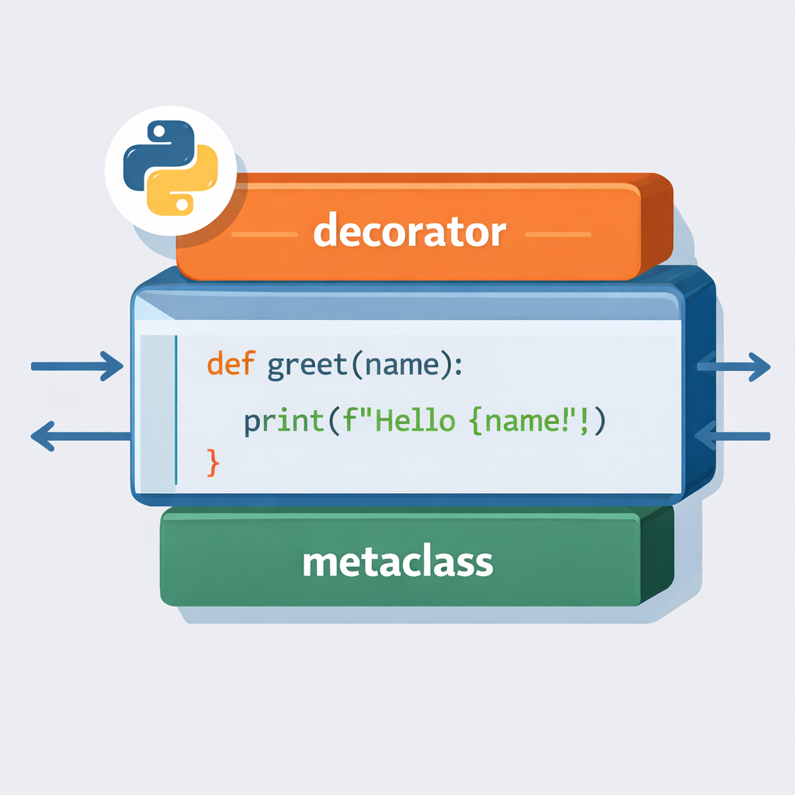
Function Decorators
Function decorators wrap functions to add behavior transparently.
Functions are first-class objects
Decorators receive and return functions
Applied using @decorator syntax
Common uses: logging, timing, validation
Decorator order affects execution
Notes:
Emphasize that decorators execute at definition time, not runtime setup.

Slide 4
Source Code Example
def log_call(func):
def wrapper(*args, **kwargs):
print(f"Calling {func.__name__}")
return func(*args, **kwargs)
return wrapper
@log_call
def greet(name):
print(f"Hello {name}")

Slide 5
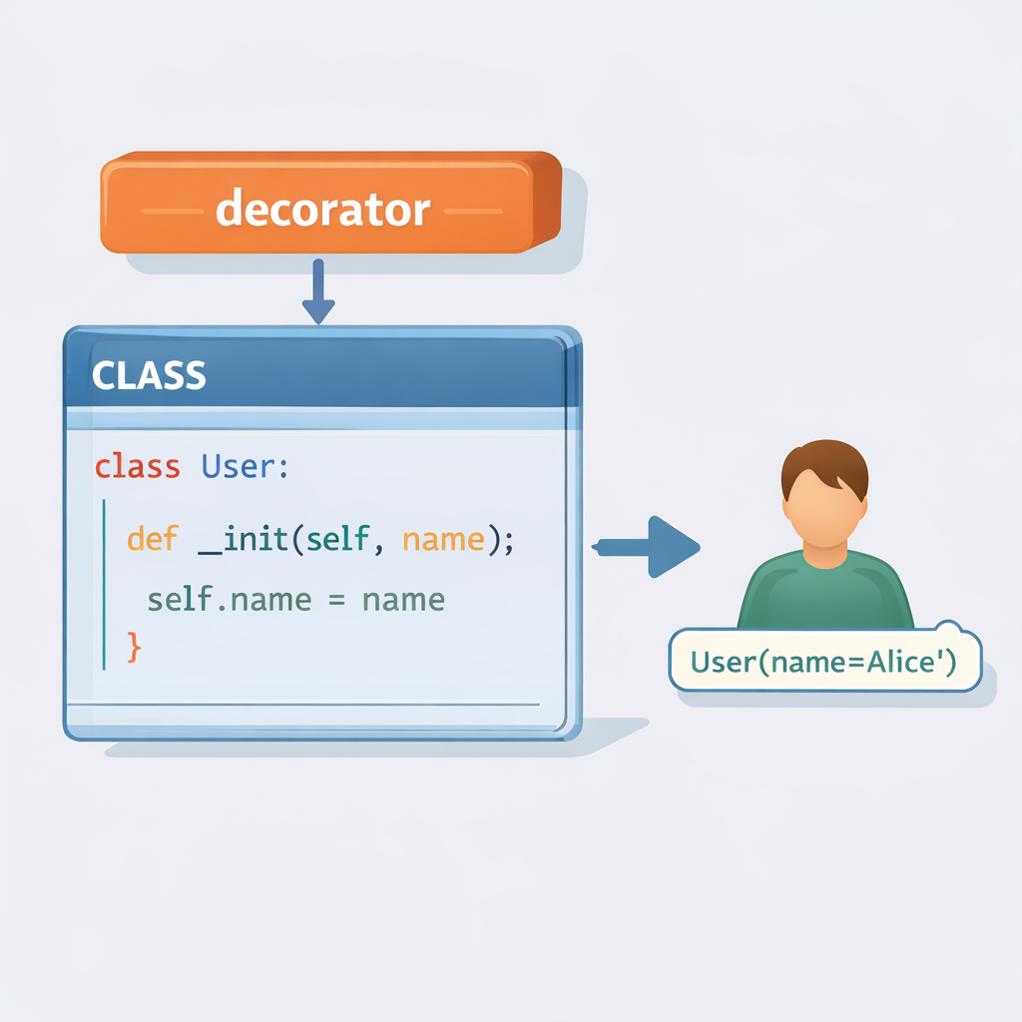
Class Decorators
Class decorators modify classes when they are created.
Receive the class object as input
Can add methods or attributes
Execute once at class definition
Often used for registration or instrumentation
Simpler alternative to metaclasses
Notes:
Highlight: class decorators are powerful but still readable compared to metaclasses.

Slide 6
Source Code Example
def add_repr(cls):
def __repr__(self):
return f"{cls.__name__}({vars(self)})"
cls.__repr__ = __repr__
return cls
@add_repr
class User:
def __init__(self, name):
self.name = name

Slide 7
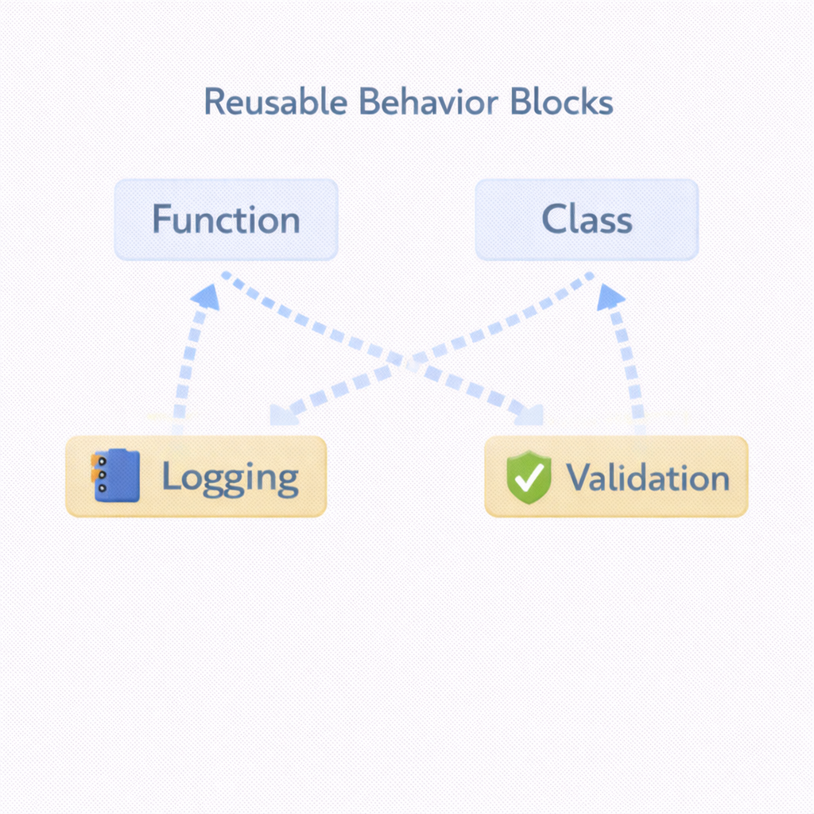
When to Use Decorators
Decorators are best for cross-cutting concerns.
Logging
Authorization checks
Input validation
Caching or timing
Feature toggles
Notes:
Connect decorators to earlier labs on mix-ins and logging.

Slide 8
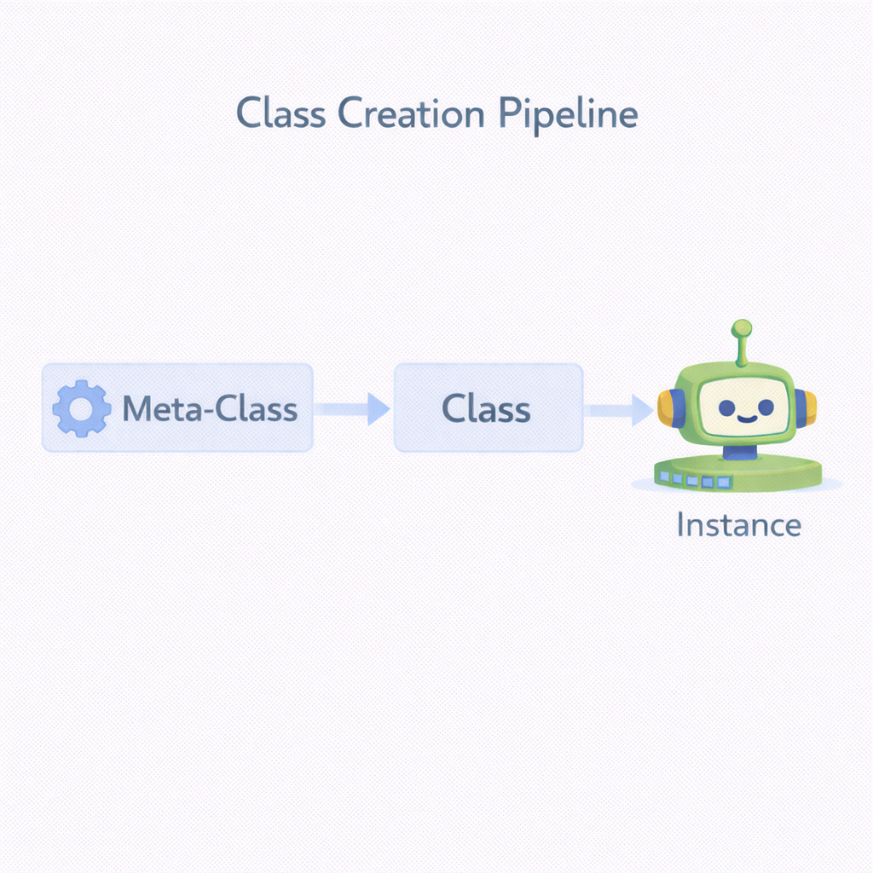
Introduction to Metaclasses
Metaclasses control how classes themselves are created.
Classes are objects too
Default metaclass is type
Metaclasses run before class exists
Modify class attributes or behavior
Mostly used by framework
Notes:
Tell students: “If you’re not building a framework, you probably don’t need this.”

Slide 9
Source Code Example
class MyMeta(type):
def __new__(cls, name, bases, attrs):
attrs["created_by"] = "MyMeta"
return super().__new__(cls, name, bases, attrs)
class Demo(metaclass=MyMeta):
pass

Slide 10
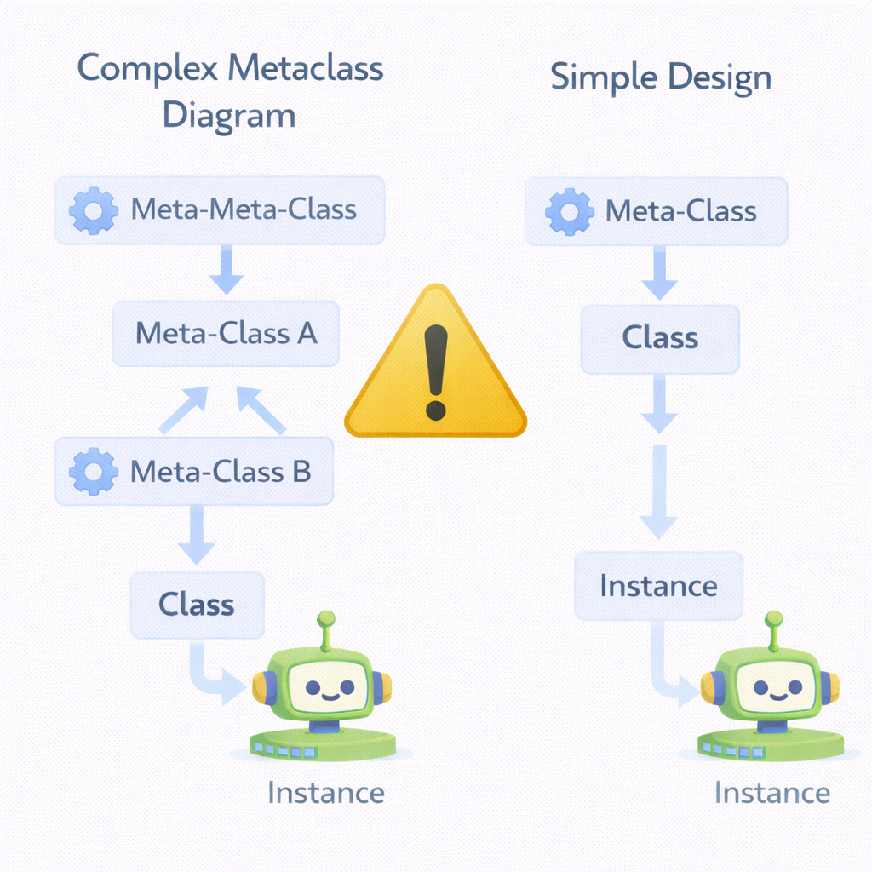
Metaclasses: Use With Extreme Care
Metaclasses are powerful but dangerous in everyday code.
Increase cognitive load
Complicate debugging
Harder for teams to understand
Often replaceable with decorators
Rarely justified in application code
Notes:
Mention Django ORM as a valid case—but not typical applications.

Slide 11
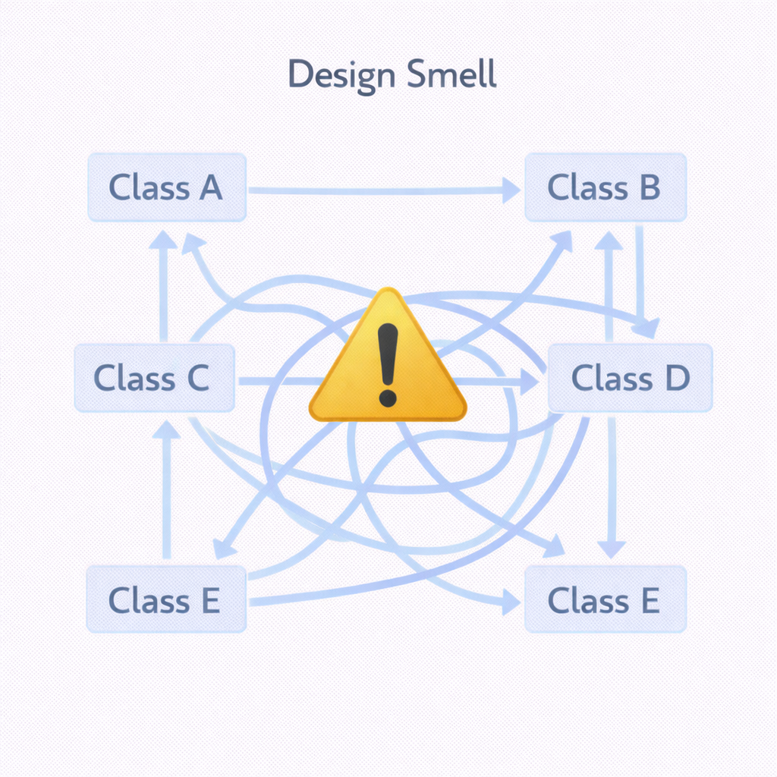
Common Class Design Pitfalls
Most class problems come from overengineering.
Deep inheritance hierarchies
“God” classes with too many responsibilities
Premature abstraction
Tight coupling
Overuse of advanced features
Notes:
Ask: “Could this be solved with fewer classes?”

Slide 12
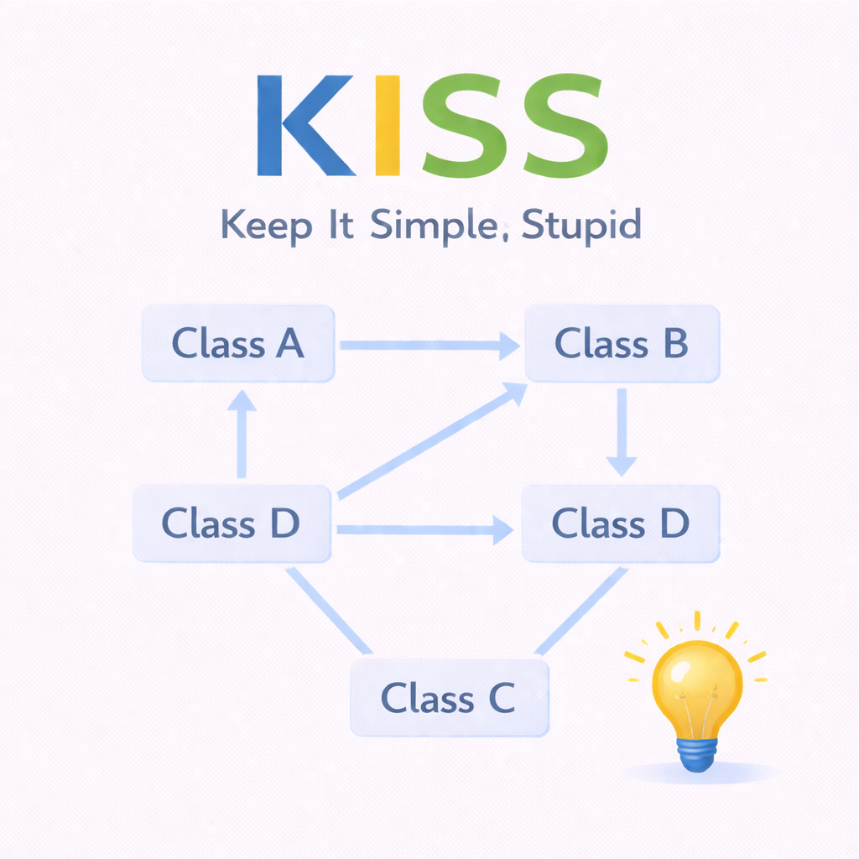
KISS Principle (Keep It Simple, Stupid)
Simple designs are easier to maintain, test, and extend.
Readability over cleverness
Fewer abstractions = fewer bugs
Start simple, refactor later
Explicit is better than implicit
Optimize only when necessary
Notes:
Tie this back to Python’s design philosophy (Zen of Python).

Slide 13
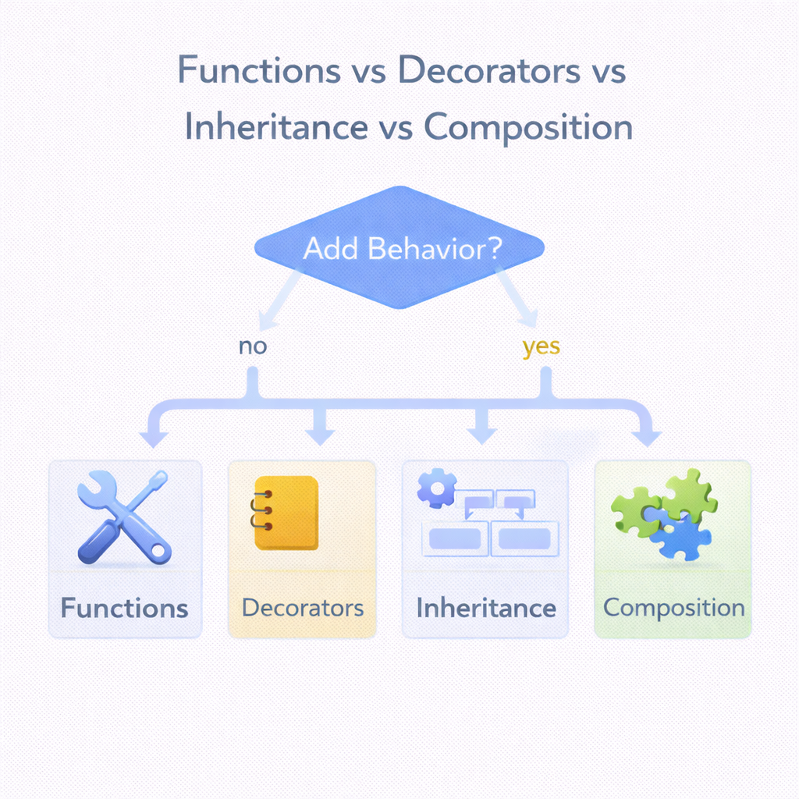
Choosing the Right Tool
Not every problem needs a decorator or metaclass.
Use functions for simple behavior
Use classes for state + behavior
Use decorators for cross-cutting concerns
Use composition before inheritance
Avoid “magic” unless necessary
Notes:
Reinforce design decision-making, not feature memorization.

Slide 14
Decorators & Class Gotchas: Summary
Powerful features demand disciplined design.
Decorators modify behavior cleanly
Class decorators and metaclasses act at definition time
Overengineering causes fragile systems
KISS keeps code maintainable
Clarity always beats cleverness
Notes:
Close with: “If your design needs a long explanation, it probably needs simplification.”

